Slide 1
CyBot-Warrior Robot Cyber-Security Warrior-Shakeel
Name : Md Mehedi Hasan
ID : 16201073
SEC : A2

Slide 2
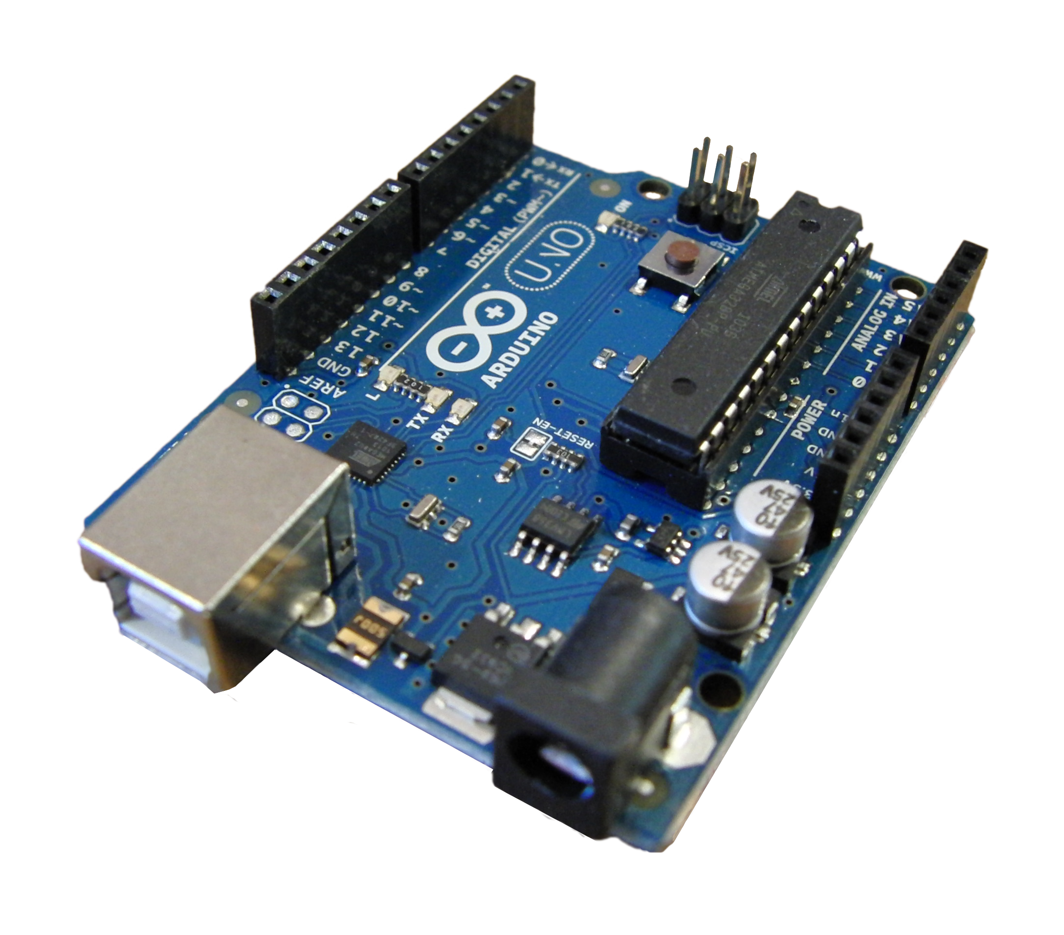
What is Cybot Warrior robot?
CyBot Robot Car is a Arduino Based Bluetooth Controlled Autonomus Car Which can jam every wifi connection near 10 meter also it have obstacle avoidance features and also will have a lots of features regarding cyber security and hacking coming soon….
So this robot are going to make this wifi security testing easy and Automatically Make a Environment for WiFi and Other Cyber Security Testing!

Slide 3
Three Key Features of This Software
Mobile Control CyBot with Obstacle Avoidance
WiFi Jammer
WiFI Router
This Cybort Robot Can Be Controlled using Bluetooth available device like Mobile phone Blue tooth, Bluetooth joysticks and other Bluetooth device
This Cybot Robot Can Jam Every wifi connection and deauthenticate every wifi devices like mobile phones ,desktop computers and laptop.
Also this Cybot Robot can be use as a wifi router with non detectable location and in every 5 second it’s ip address will be changed. No one can trace the location of the wifi users

Slide 4
Technology & Programming Language
Arduino
Arduino programming
Equipment list
I’m using Arduino UNO as a embedded system and Arduino coding for Bluetooth controlled module
For wifi jamming I’m using ESP8266 NodeMCU wifi module for wifi jamming
Arduino UNO
Motor Driver L239D
4 DC Motor & Wheels
Car Case and some connecting wire

Slide 5
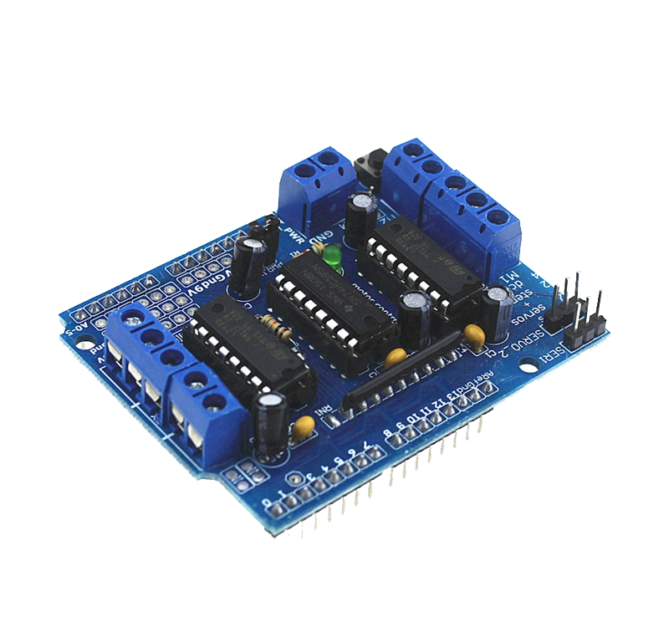
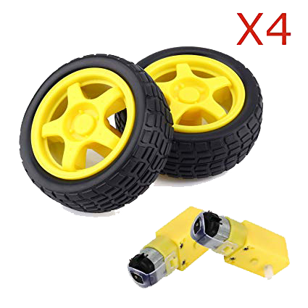
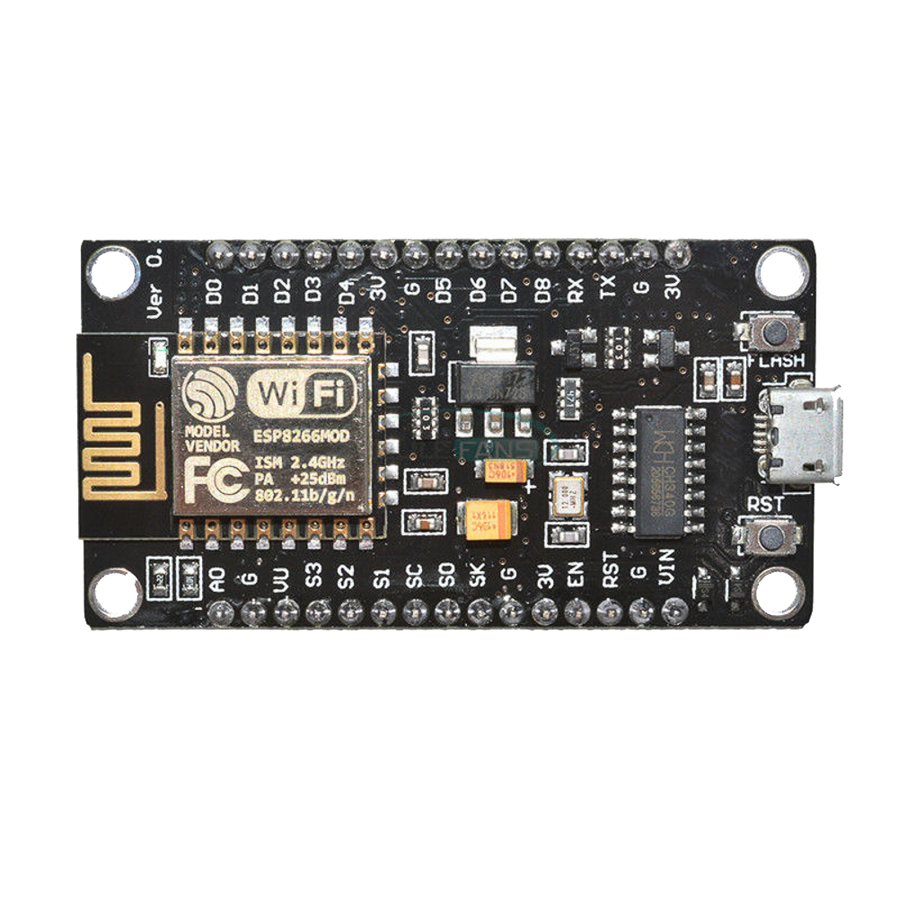
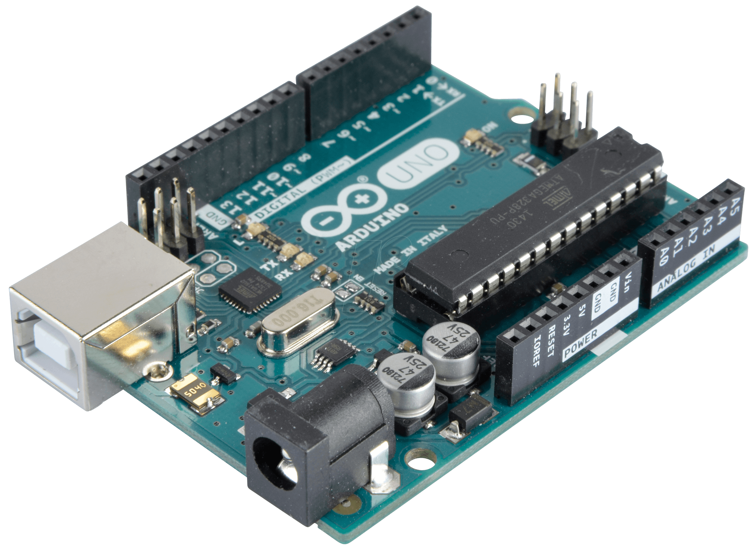
Equipment's Pictures
4 DC Motor &Wheels
ESP8266 NodeMCU
Arduino UNO
Motor Driver L239D

Slide 6
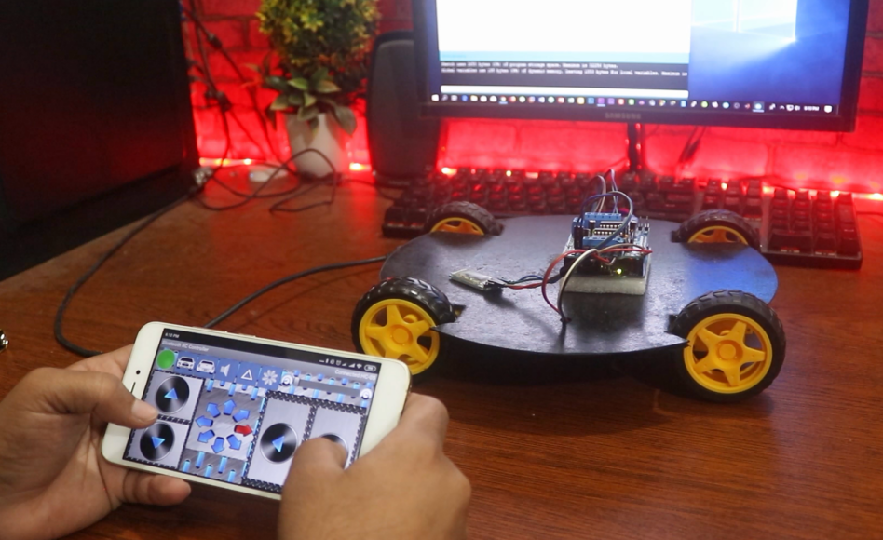
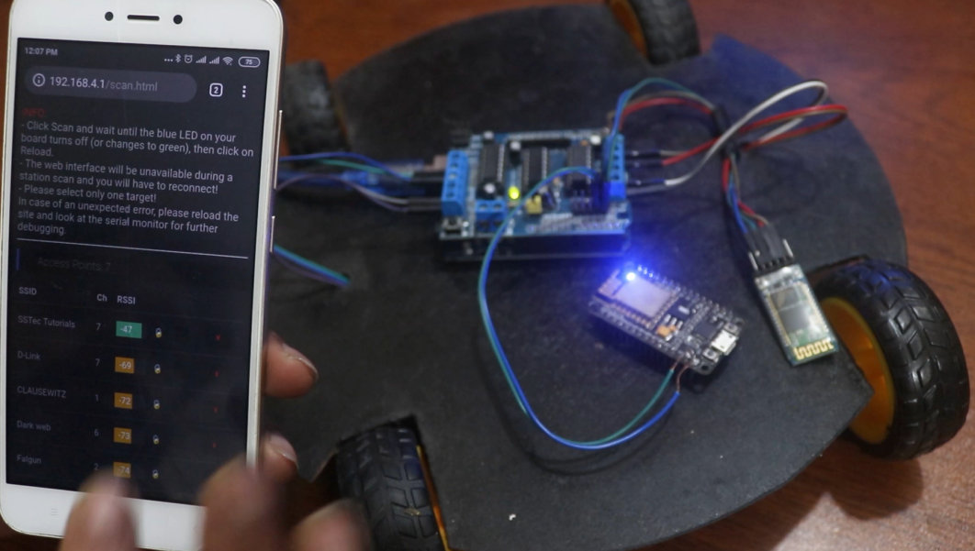

Development Environment
Bluetooth Control
WiFi Jamming using Cybot
Penetration Testing
Mobile Control
Any Browser
WIFI Jamming

Slide 7
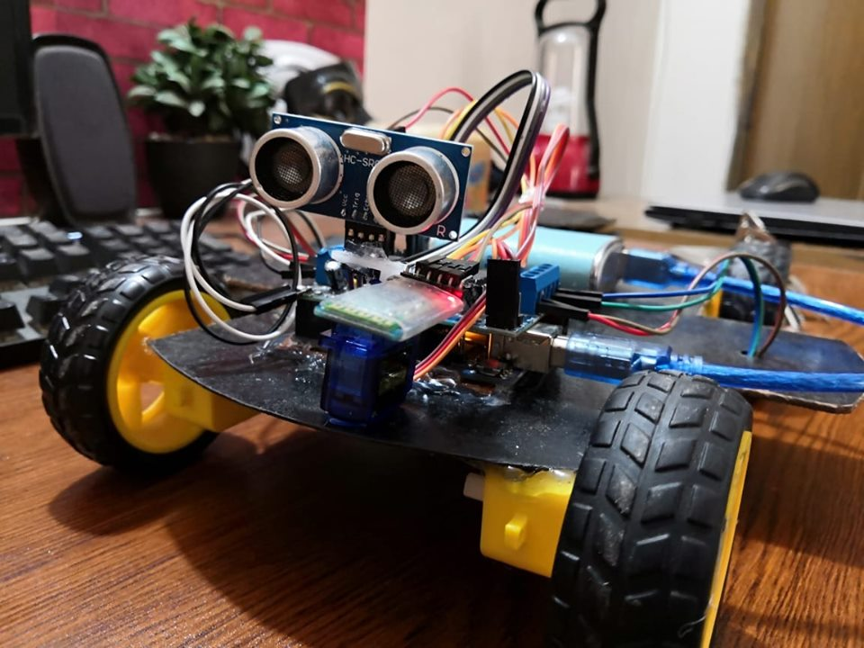

Slide 8
Project Planning
Week 3
Week 4
WEEK 5
Requirements Analysis
Select Library Module
Design Diagrams
Design Circuit
Prototype & Review
Error Checking
Finalize Submission

Slide 9
Any Questions?

Slide 10
THANK YOU ALL !

